Slide 1

Recruitment Process
Team SAKura

Slide 2
About Sakura
Switzerland based mid-sized Consulting company
Specialized in providing Digital Solutions
Clients include: Banking, Pharma and Construction companies

Slide 3
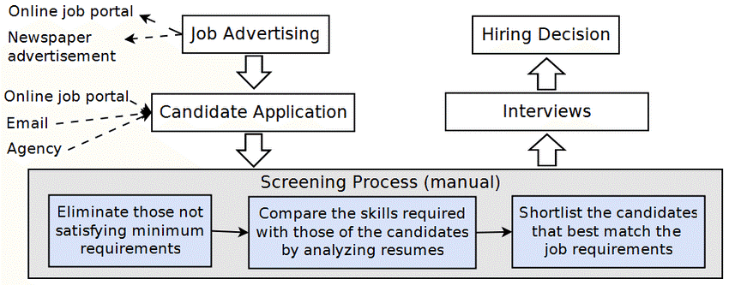
As-Is Process
As . Is Process partners
Networking
Job sites
External resourcing consultancies
News papers

Slide 4
Challenges
Human Intensive process
No real time view on the whole process
Inefficient talent sourcing in regards of total time taken and costs incurred
Building talent pools proactively
Unable to focus on hiring skilled consultants
Less Competitive
Future Business Development Plans

Slide 5
To-Be Process Flow
Process Flow Screen shot and explanation video

Slide 6
Process Capability
Generate Candidates score based on skill-sets therefore able to recruit high-skilled employees
Quick and efficient shortlisting of candidates
Real-time recruitment process overview
Easy to maintain talent pool
Digitalization of recruitment process saves time and cost

Slide 7

Conversational Chatbot
Personalised experience to the candidate
Interactively Collecting basic candidate information
Eliminates Human Intervention
Saves Recruiter’s time
Leaving positive impression on the candidate

Slide 8
Conclusion
Rationalize the recruitment process
Reduces time to hire
Eliminates manual intervention and mistakes
Better candidate experience
Focus on value added task

